Slide 1


Amazon Employee Review Analysis

Slide 2
Outline
Identify the Problem
About Dataset
Data Cleaning
EDA
Suggestion

Slide 3
The Problem
The Amazon comes to solve the issue of getting low rating from the Employees

Slide 4
To perform a comprehensive analysis of Amazon employee reviews, assessing factors such as place, salary, career growth, department, work satisfaction, and job security. The goal is to gain insights into employee sentiment and identify opportunities for improving workplace satisfaction, retention, and overall organizational performance.

Slide 5
About Dataset
Kaggle is the source for our Dataset.These are the columns
Index: An exclusive identifier for each individual review entry.
Name: The job title or role of the employee providing the review.
Place: The geographical location or city where the employee works.
Job Type: The employment status of the reviewer (e.g., Full Time).
Department: The specific department or functional area within the organization.

Slide 6
Overall Rating: A numerical rating given by the employee for their overall job satisfaction.
Work Life Balance: Rating indicating the work-life balance experienced by the employee.
Skill Development: Rating reflecting the opportunities for skill enhancement and growth.
Salary and Benefits: Rating assessing the satisfaction with compensation and benefits.
Job Security: Rating expressing the employee's sense of job security.
Career Growth: Rating indicating the perceived career advancement opportunities.
Work Satisfaction: Rating showcasing the employee's contentment with their work.
Likes: Positive aspects and pros highlighted by the employee in their review.
Dislikes :Negative aspects and cons mentioned by the employee in their review.

Slide 7
Data cleaning
Before going into cleaning part we copied our dataset by using the Copy Library.
We dealled with missing/null values for each columns. To know those values we used Dataframe['Column_name'].isnull().sum()
After that we observed some irrelevant data in the columns we observed that irrelevant data by using AR['Column_name'].value_counts()
So,we replaced those values with other values in the column by using AR['Column_name'].replace('Del,'New Delhi',inplace= True)

Slide 8
EDA Process in Jupyter Notebook

Slide 9
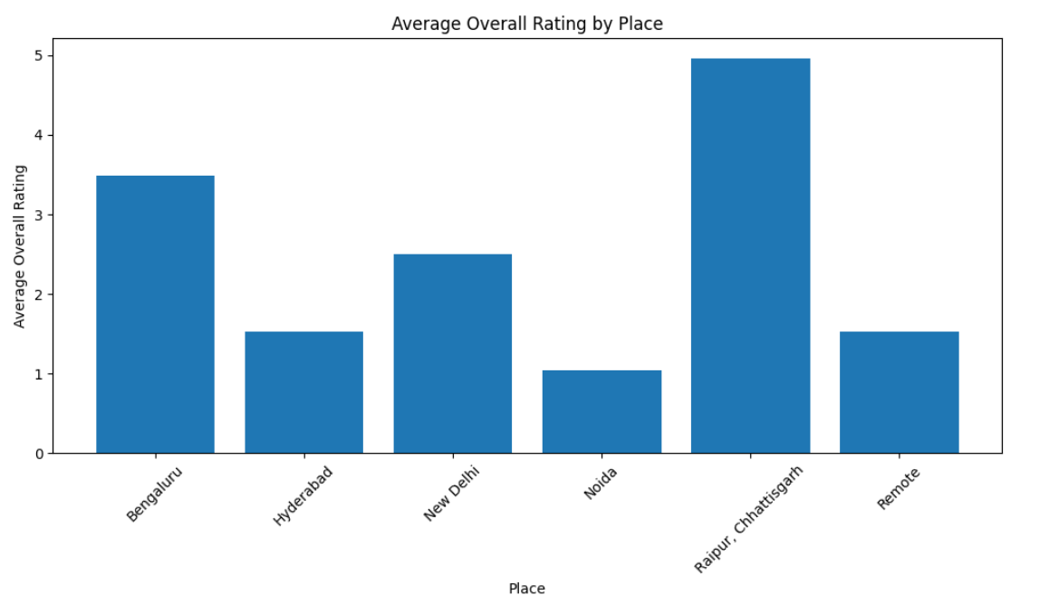
Average rating by price
From this bar graph, we can say that the Noida has Lowest Overall Rating while compare to remaining cities. And Raipur has highest Overall rating

Slide 10
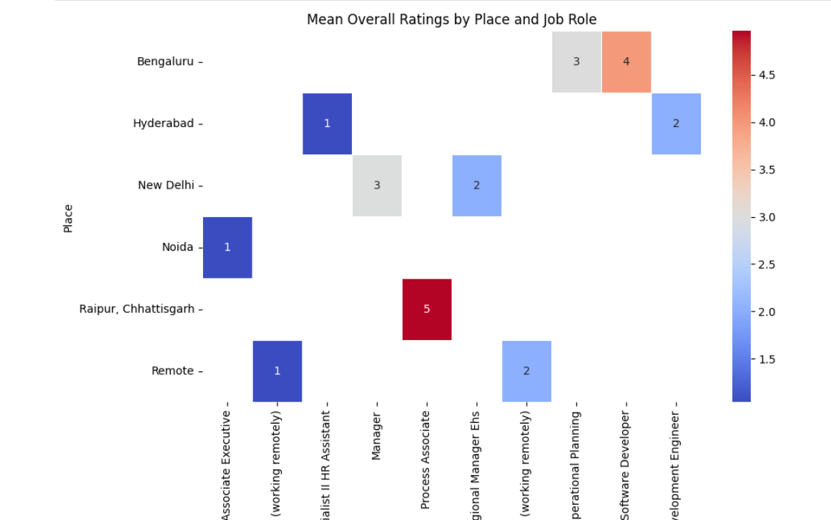
Mean overall rating by place & Job
From this heat map, we can see that the associate executive role in Noida average overall ratings is 1. From this we can conclude that Associate executive in Noida city are not satisfied with the amazon Company.

Slide 11
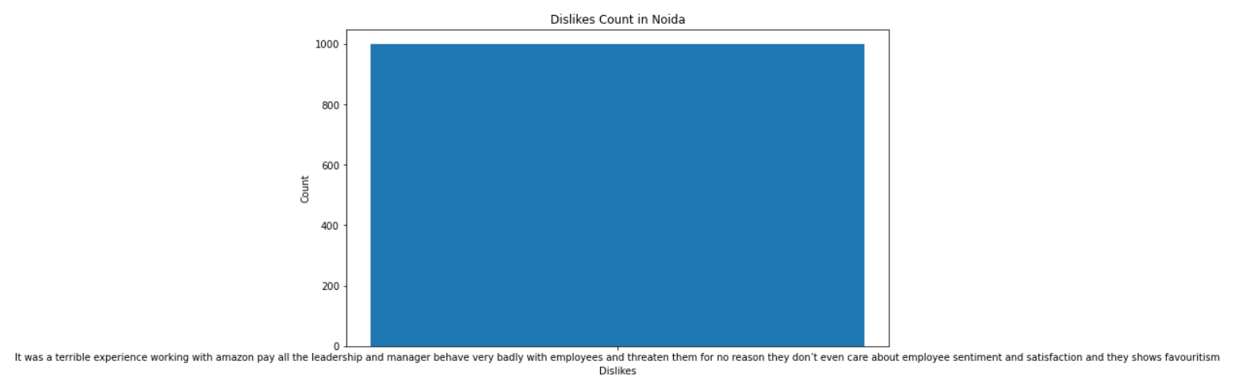
Comment on Low Overall Rating
The most dislike in Noida due to this below comment
It was a terrible experience working with amazon pay all the leadership and manager behave very badly with employees and threaten them for no reason they don’t even care about employee sentiment and satisfaction and they shows favouritism

Slide 12
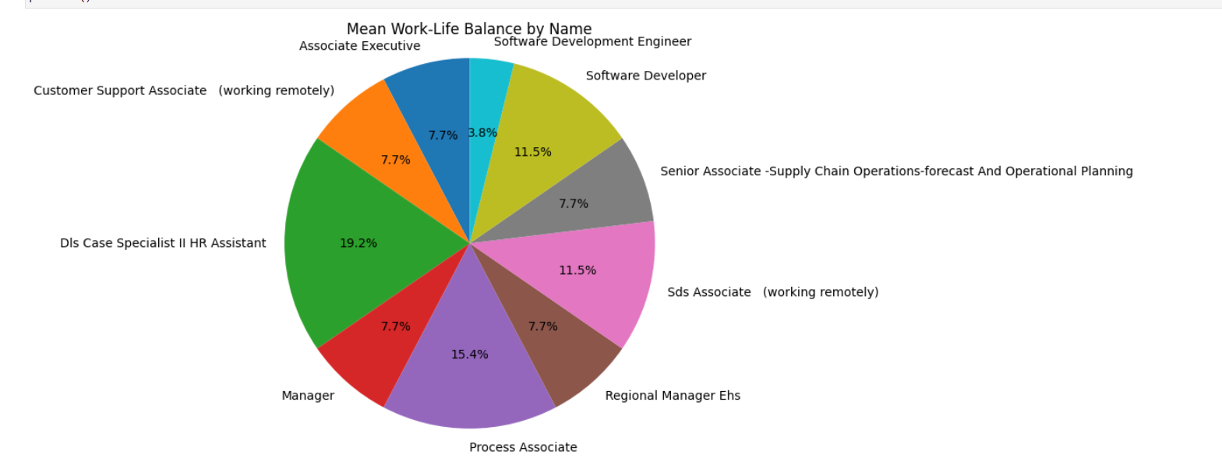
Mean Work Life Balance by Role
Avg Work-Life Balance by Job
From this pie graph, we can see that software Developer is not satisfied with work life balance while compare with the other roles.

Slide 13
Suggestions ?

